Slide 1
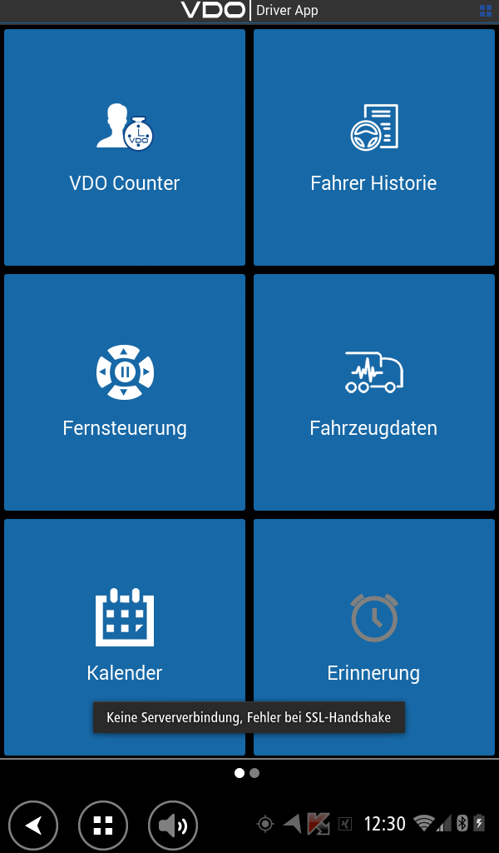
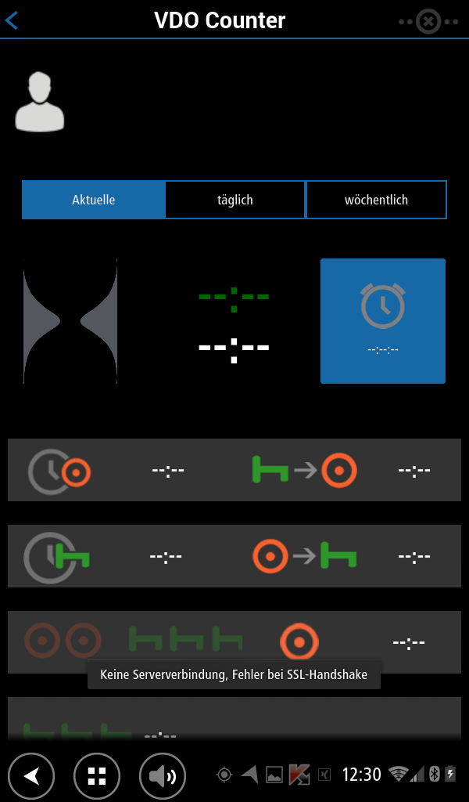
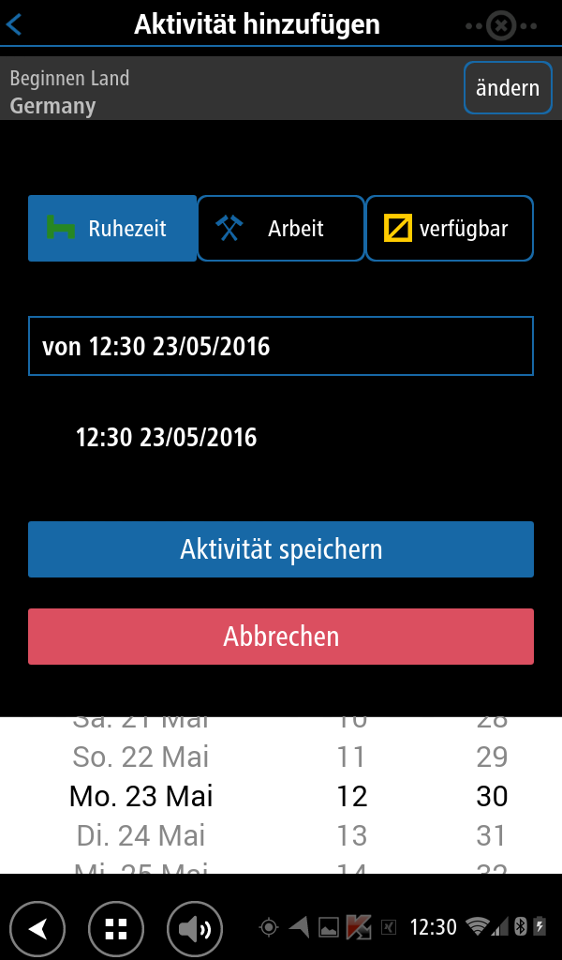
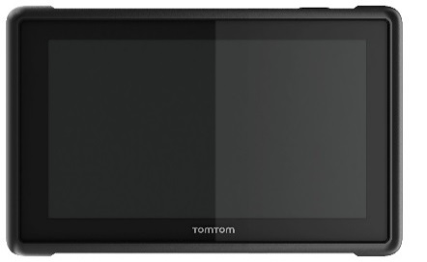
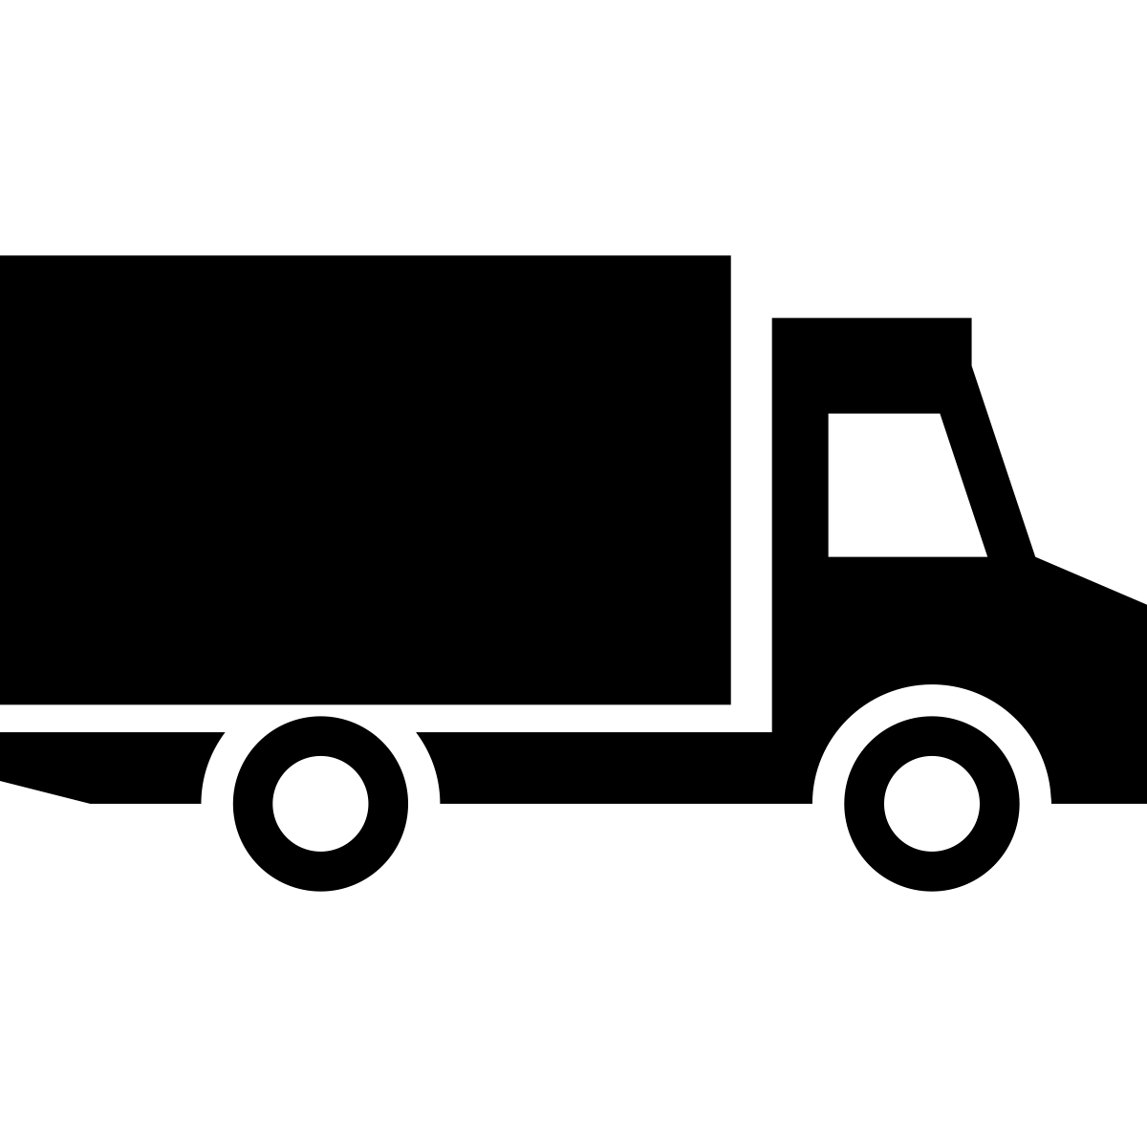
Tachograph and Fleet Solutions
For Greater Efficiency
TomTom BRIDGE: The digital tachograph made easy with Continental
The international automotive supplier, tire manufacturer and industrial partner Continental develops intelligent technologies for transporting people and their goods.
The Continental product brand VDO offers a broad range of innovative and future-oriented solutions for fleet companies and drivers – from digital tachographs right through products for automatically downloading data and professional fleet management solutions.
The solution
The DTCO® SmartLink Pro is the clever connection between the VDO digital tachograph DTCO® and the TomTom BRIDGE business platform.
All the driver has to do is to plug the SmartLink Pro into the front panel of the DTCO®. As soon as a connection is established with TomTom BRIDGE, the data of the digital tachograph is sent via Bluetooth® directly to the driver’s paired TomTom BRIDGE.
It becomes a door opener for a number of helpful apps like the VDO Driver App, which ensures that the driver can always see the driving and rest periods.
The SmartLink Pro and the VDO Driver App turn TomTom BRIDGE into an interface between driver, tachograph and fleet manager.
The results
Establish communication between DTCO® and TomTom BRIDGE by receiving and sending driver and vehicle relevant data.
Overview of VDO Counter data, which keep the drivers continuously informed about remaining driving and rest periods and help comply with regulations on driving and working hours. This allows an easier planning of routes, working hours and schedules.
Calendar display that outputs driver information when the driver card is inserted*.
Send VDO Counter data into the online data management platform TIS-Web® in order to visualise and store data in accordance with the law and analyse driver and vehicle data.
(*depending on the DTCO® Release)
“Our collaboration with TomTom BRIDGE makes it much easier than ever for companies to access and utilise driver and vehicle data” – Axel Backof, Head of Regional Sales Organisation Continental Trading GmbH.
The Bluetooth® word mark and logos are registered trademarks owned by Bluetooth SIG, Inc. and any use of such marks by TomTom is under license. Other trademarks and trade names are those of their respective owners.
Website
http://www.fleet.vdo.com/drivers/making-drivers-everyday-work-simpler/dtco-smartlink/
Regions of sale
Global
Logistics

